Slide 1
Welcome
To Open House!

Slide 2
Roberts Red Fox Rules​
Be safe.
Be respectful.
Be responsible.
​
Parents will be notified of office referrals. Students with two or more referrals will not attend the field trips for that semester.

Slide 3
Daily Schedule​
8:30-8:45 A.R.- Accelerated Reader​
8:45-9:30 UFLI
9:30-10:00 Whole Group Language Arts Instruction
10:00-10:45 Language Arts Small Group Instruction, May include Lexia ​
10:45-11:30 ​ Whole Group Math Instruction
11:30-11:55 Lunch
11:55-12:25 Recess
12:25-1:15 Science / Social Studies​
1:15-1:55 Math Small group Instruction, IXL​
1:55-2:40 Special Area​
2:40-2:50 Prepare for Dismissal
2:50 Dismissal​

Slide 4
To do:
Join REMIND to stay informed. Text @ef2b2b94 to the number 81010
Pay activity fee of $50 for the first semester if you have not already
Complete the volunteer form online to help in the classroom and chaperone on field trips

Slide 5
Procedures
Transportation Changes- Must make changes in PikMyKid before 2:00pm.
Contacting Teachers – E-mail is the best form of contact
and will be returned in a timely manner.
Conferences – We look forward to meeting with all parents
by the end of the 1st semester. You will be notified when it is time to schedule individual conferences.

Slide 6
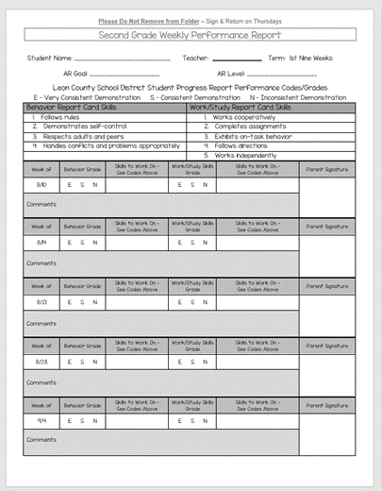
Weekly Progress Report
Helpful tool to communicate behavior and work/study skills each week.
These stay in green folders at all times.

Slide 7
Grading
Scale: 100%-90% = A
89%-80% = B
79%-70% = C
69%-60% = D
59% and below = F
Weighted grades: 80% assessments, 20% for classwork
*No extra credit per school policy*
Any paper with a letter grade or percentage is counted
towards the report card grade.
FOCUS: Opportunity for you to view your child’s grades throughout the year. Make sure you sign in regularly.
Papers with a star, check, smiley face, or DT written
at the top were completed together or used as practice.

Slide 8
Activity Fee
$50 due Aug. 31st
Scholastic News ($8)
Florida Studies Weekly Social Studies ($11)
Class/Field Trip T-Shirt ($7)
Craft Supplies for holidays and special occasions ($5)
Classroom organizational folders ($2)
Supplemental Supplies ($2)
San Mission Luis field trip ($15)

Slide 9
Homework
Purpose – Homework is designed to allow students to have independent practice, promote good study habits, and foster responsibility.
Procedure – Assignments will go home each Friday and are due the following Thursday. Incomplete assignments will not receive full credit.
Parent Involvement
*Create a quiet work environment.
*Keep paper, pencils, crayons, glue, and scissors on hand.
*Allow child to work independently.
*Check over your child’s work so that corrections can be made before turning it in on Thursday.
*Please don’t wait until the last minute.

Slide 10
Homework
Reading Log – 20 Minutes each night
Spelling sentences
Grammar practice
Reading comprehension worksheet
Math practice and fluency
Other assignments as needed

Slide 11
Accelerated Reader
Students select books based on their reading level (this is written at the top of their Weekly Behavior Report)
Students read books two times independently
Students take a comprehension test on the computer and earn points
Teachers monitor student progress and reward students
All students are expected to take at least two A.R. tests each week
Each child has an individual point goal with at least 85% accuracy
There are grade level incentives for students meeting 85% or higher accuracy on AR tests and also making their reading point goal
Students receive assessment grades for their point goal and their accuracy, as part of their Language Arts grade.

Slide 12
Curriculum
Reading – Savvas
7 day schedule
5 days of instruction
Day 6 Assessment
Day 7 Writing
Math – Go Math
Science – Science Fusion
Social Studies – Florida Studies Weekly

Slide 13
UFLI
UFLI-Phonics Program
5 day schedule
4 days of instruction
Day 5 Show What You Know (Classwork grade consists of 10 words to spell and 2 dictation sentences to write)

Slide 14
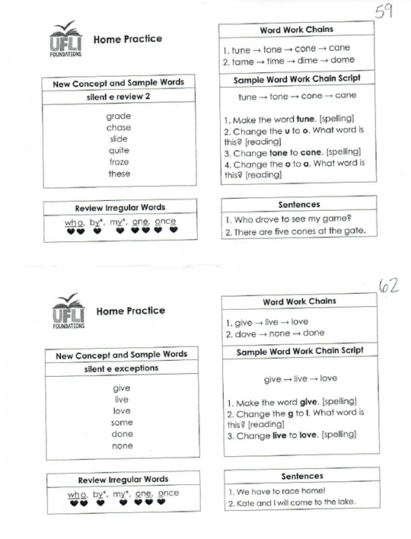

Slide 15
Other notes:
Please have your child wear their HOUSE
colors each Friday to show their school spirit!
Parents are welcome to eat lunch with your
child. You may combine with other parents
and children, however, you may not have more
than your child in your personal group. You may
eat at the round table.

Slide 16
Thank you for coming!

